Slide 1
Exploring the Mechanisms of Output Interference During Cued Recall Using Metamemory Judgments
Taylor Curley, PhD Air Force Research Laboratory tmc2737@gmail.com

Slide 2
Acknowledgements
I would like to thank several people, including:
Chris Hertzog (Georgia Tech)
Emily Lustig (Georgia Tech)
MacKenzie Hughes (Georgia Tech)
Rick Thomas (Georgia Tech)
John Dunlosky (Kent State)
Paul Verhaeghen (Georgia Tech)
Dobromir Rahnev (Georgia Tech)
Megan B. Morris (AFRL)
Leslie Blaha (AFRL)
Technical notes:
This project was part of a dissertation project at the Georgia Institute of Technology and funded in part by a Ruth L. Kirschstein National Research Service Award (NRSA) Institutional Research Training Grant (T32) from the National Institutes of Health (National Institute on Aging) Grant 5T32AG000175.
All code and figures were run using Julia and R, and this presentation was compiled using Quarto.
Most analyses can be found on OSF: osf.io/2eqv7.
Notes:
These are optional notes.

Slide 3
Overview

Slide 4
Memory Interference

Slide 5
Memory Awareness

Slide 6
Current Study

Slide 7
Methods
Notes:
These are optional notes.

Slide 8
Participants
CONDITION | N | M (age) | SE (age)
Related Cues | 49 | 20.24 | 0.57
Unrelated Cues | 36 | 19.73 | 0.25
Sample consisted of 85 college-aged students recruited from Georgia Tech’s research subject pool.
Random (blind) assignment to 1 of 2 between-subjects conditions:
Related Cues
Unrelated Cues
Notes:
These are optional notes.

Slide 9
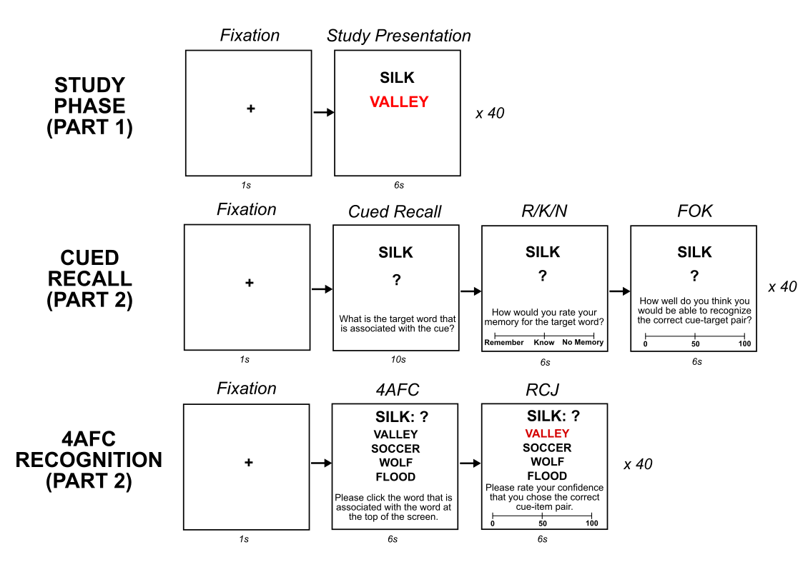
Procedure
The experimental procedure followed in 3 parts:
such and such
such and such
such and such
Notes:
These are optional notes.

Slide 10
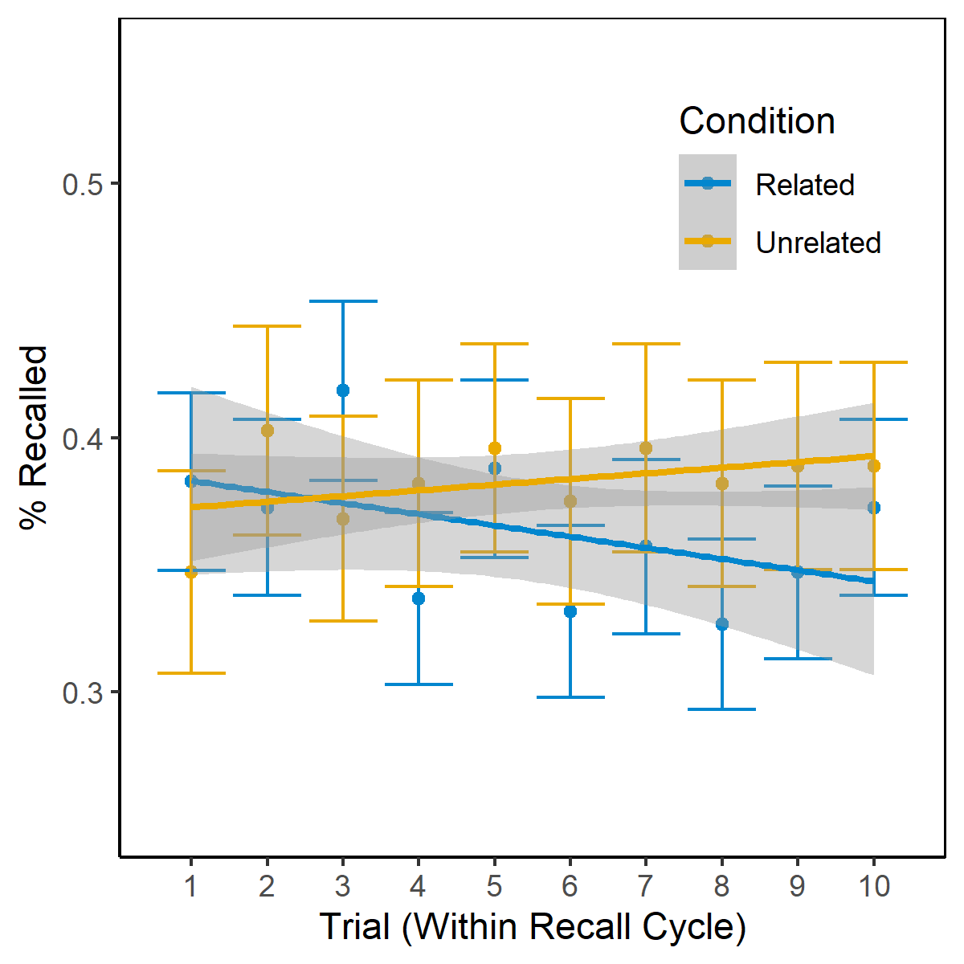
Quick Results

